Slide 1
Procure to pay(P2P) process
NAME : HARI VISWESH MCA (SS)
REG NO : 2019272009
Guide : Ms.S.Kanimozhi
Teaching Fellow

Slide 2
INTRODUCTION
The procure-to-pay (P2P) process combines a company’s procurement and accounts payable functions.
The process starts when the need arises for goods or services and ends with the payment for those goods or services.
It’s aim is to make the entire production resources chain as fast, secure, and cost-effective as possible.

Slide 3
The Purchase Order Process, during which:
Purchase requisitions are created and approved.
Vendors are evaluated and selected.
Purchase orders are issued for the required goods and services.
The Receiving Process, during which:
Goods and services are received or executed.
For goods, receiving documents are reviewed and logged

Slide 4
The Invoice Approval Process, during which:
Invoices are received and invoice processing completed.
Invoices are reconciled and cross-checked with the original PO and goods receipts or receiving documents (three-way matching).
Errors are recorded and corrected.
Approved invoices are paid

Slide 5
Collaborative filtering:
Collaborative filtering models compute their predictions using a dataset of feedback from users to Vendor
Content-based models:
Content-based models use only characteristic features of the items
Hybrid recommendation:
which can be considered as the combination of the content and collaborative filtering method

Slide 6
Module
Vendor maintenance
Create Purchase Requisition.
Vendor recommendation
Generate Purchase Order.
Receive Purchase Order Approval.
Issue Goods Receipt.
Receive and Review Vendor Invoice.
Approve Vendor Invoice.
Pay Vendors through Accounts Payable.
Product tracking

Slide 7
Objective:
Procure-to-pay is the process of integrating purchasing and accounts payable systems to create greater efficiencies.
It exists within the larger procurement management process and involves four key stages: selecting goods and services;
enforcing compliance and order; receiving and reconciliation; invoicing and payment

Slide 8
OVER-ALL ARCHITECTURE

Slide 9
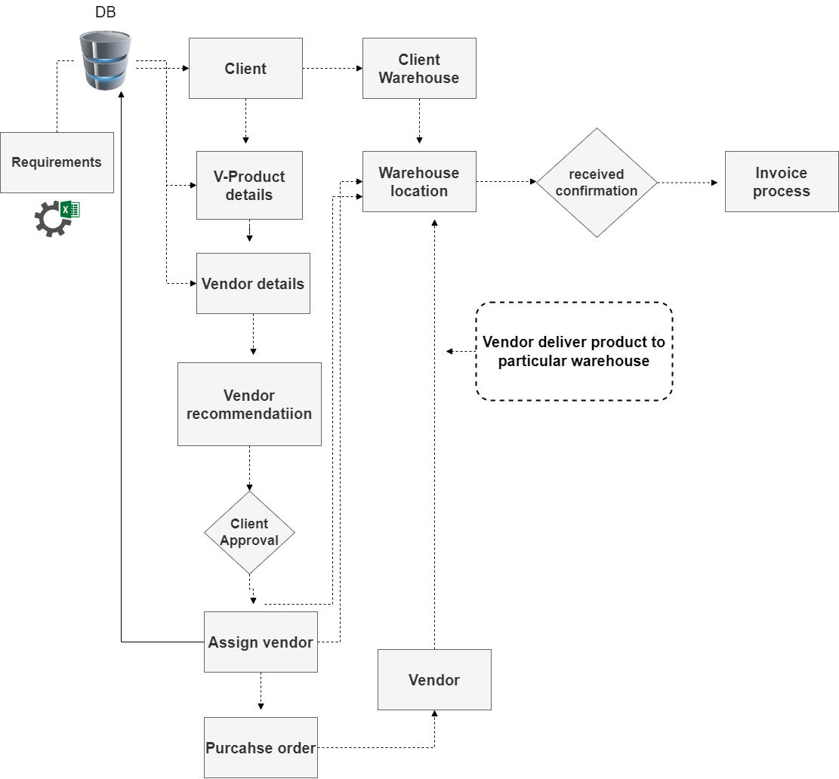

Slide 10
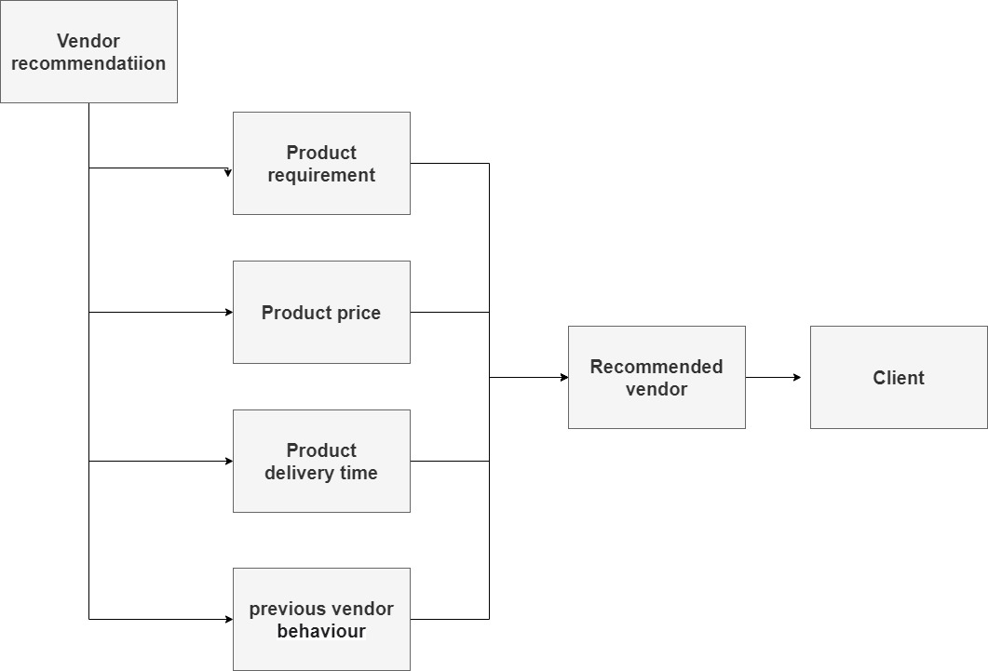

Slide 11
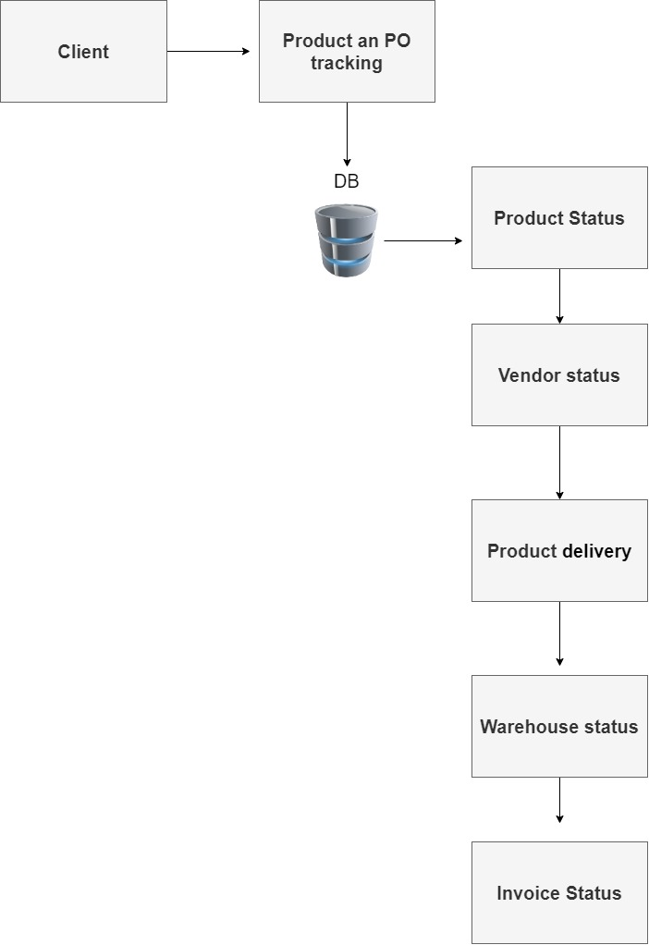
Product tracking

Slide 12
LIST OF MODULES

Slide 13
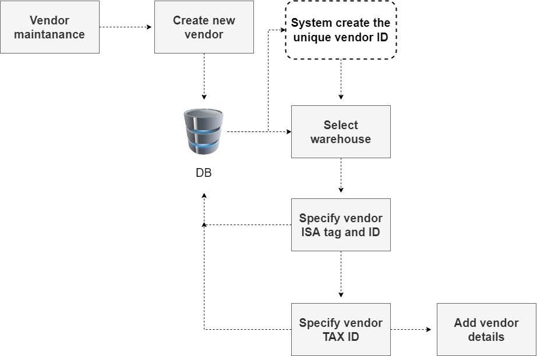
Maintaining Vendor details

Slide 14
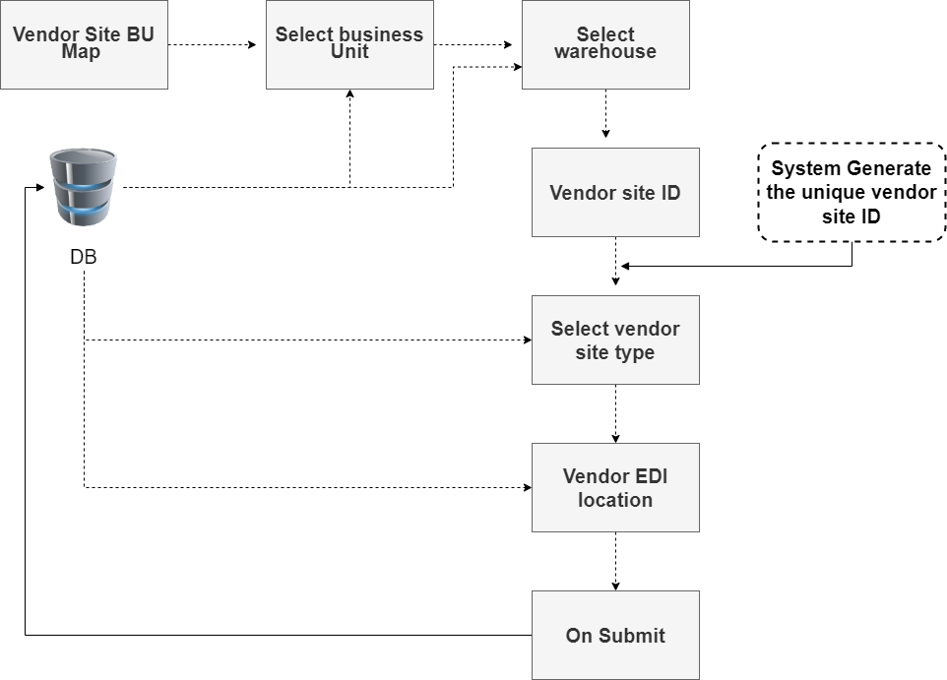
Mapping Vendor with BU and Site

Slide 15
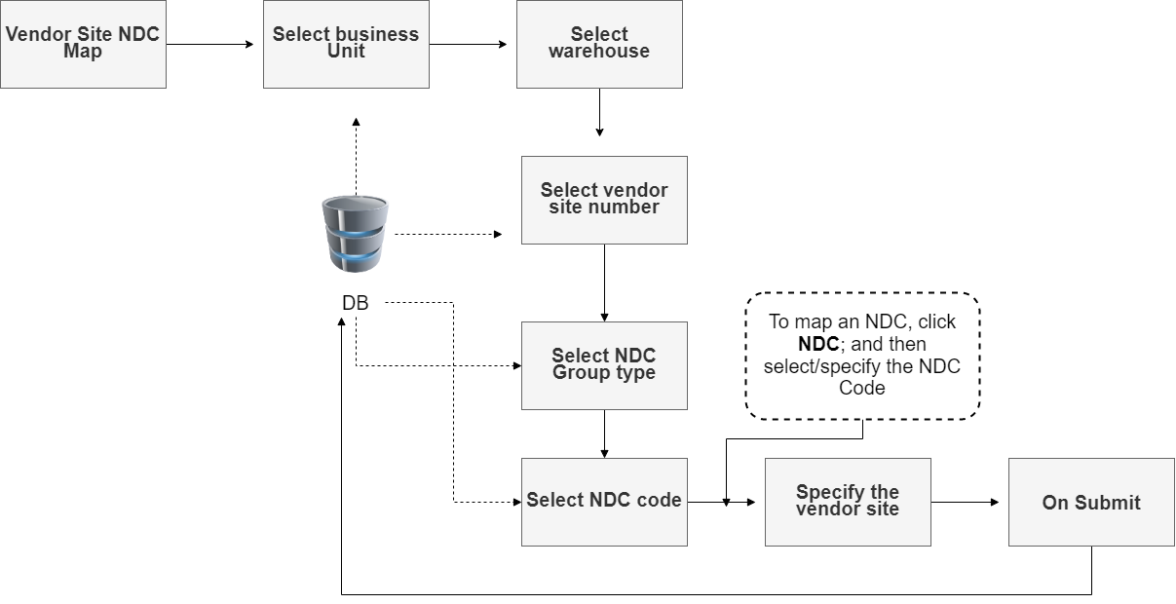
Mapping NDC with Vendor Site and BU

Slide 16
LITERATURE REVIEW
S.No. | Author name & Paper title | Concept in the paper (Algorithm, Advantages, Limitations, Future enhancement) | Paper details
1. | Fatima Zohra Trabelsi, Amal Khtira and Bouchra El Asri IMS Team, Hybrid Recommendation Systems: A State of Art | In this paper, Recommendation systems have become more important and popular in many application areas such as music, movies, e-commerce, advertisement and social networks. Recommendation systems use either collaborative filtering, content-based filtering or hybrid filtering in order to propose items to users, and each type has its weaknesses and strengths. In this paper, we present the results of a literature review that focuses specifically on hybrid recommendation systems. The objective of this review is to identify the problems that hybrid filtering tends to solve and the different techniques used to this end | In Proceedings of the 16th International Conference on Evaluation of Novel Approaches to Software Engineering (ENASE 2021), pages 281-288 ADMIR Laboratory, Rabat IT Center, ENSIAS, Mohammed V University, Rabat, Morocco

Slide 17
S.No. | Author name & Paper title | Concept in the paper (Algorithm, Advantages, Limitations, Future enhancement) | Paper details
2. | Ko, H.; Lee, S.; Park, Y.; Choi, A. A Hybrid Recommendation System for Marine Science Observation | With the development of ocean exploration technology and the rapid growth in the amount of marine science observation data, people are faced with a great challenge to identify valuable data from the massive ocean observation data. A recommendation system is an effective method to improve retrieval capabilities to help users obtain valuable data. The two most popular recommendation algorithms are collaborative filtering algorithms and content-based filtering algorithms, which may not work well for marine science observation data given the complexity of data attributes and lack of user information. In this study, an approach was proposed based on data similarity and data correlation. Data similarity was calculated by analyzing the subject, source, spatial, and temporal attributes to obtain the recommendation list. Then, data correlation was calculated based on the literature on marine science data and ranking of the recommendation list to obtain the re-rank recommendation list. The approach was tested by simulated datasets collected from multiple marine data sharing websites, and the result suggested that the proposed method exhibits better effectiveness. | MDPI stays neutral with regard to jurisdictional claims in published maps and institutional affiliations

Slide 18
LITERATURE REVIEW
S.No. | Author name & Paper title | Concept in the paper (Algorithm, Advantages, Limitations, Future enhancement) | Paper details
3. | Saman Forouzandeh, Mehrdad Rostami & Kamal Berahmand A Hybrid Method for Recommendation Systems | Recommender systems have been pervasively applied as a technique of suggesting travel recommendations to tourists. Actually, recommendation systems significantly contribute to the decision-making process of tourists. A new approach of recommendation systems in the tourism industry by a combination of the Artificial Bee Colony (ABC) algorithm and Fuzzy TOPSIS is proposed in the present paper. A multi-criteria decision-making method called the Techniques for Order of Preference by Similarity to Ideal Solution (TOPSIS) has been applied for the purpose of optimizing the system. Data were gathered through a 1015 online questionnaire on the Facebook social media site. In the first stage, the TOPSIS model defines a positive ideal solution in the form of a matrix with four columns, which indicates factors that get involved in this study. In the second stage, the ABC algorithm starts to search amongst destinations and recommends the best tourist spot to users. | Published by Taylor & Francis Group on behalf of the Fuzzy Information and Engineering Branch of the Operations Research Society, Guangdong

Slide 19
Mahout Recommender Engine
Mahout has a non-distributed, non-Hadoop-based recommender engine. You should pass a text document having user preferences for items.
And the output of this engine would be the estimated preferences of a particular user for other items.

Slide 20
Maintaining Vendor Details
We can use the Vendor screen for creating and maintaining the vendor (vendor group) details, which will be used to group the vendor sites.
Click New to create the new Vendor and specify the description.
The system automatically generates the Vendor ID.
Select the Warehouse against the Vendor has to be created.
Specify the unique Vendor ISA Tag / Receiver ID for the Vendor.
Specify the Vendor Tax Id.
On clicking Submit, the system displays the defined Vendor details in the grid.

Slide 21
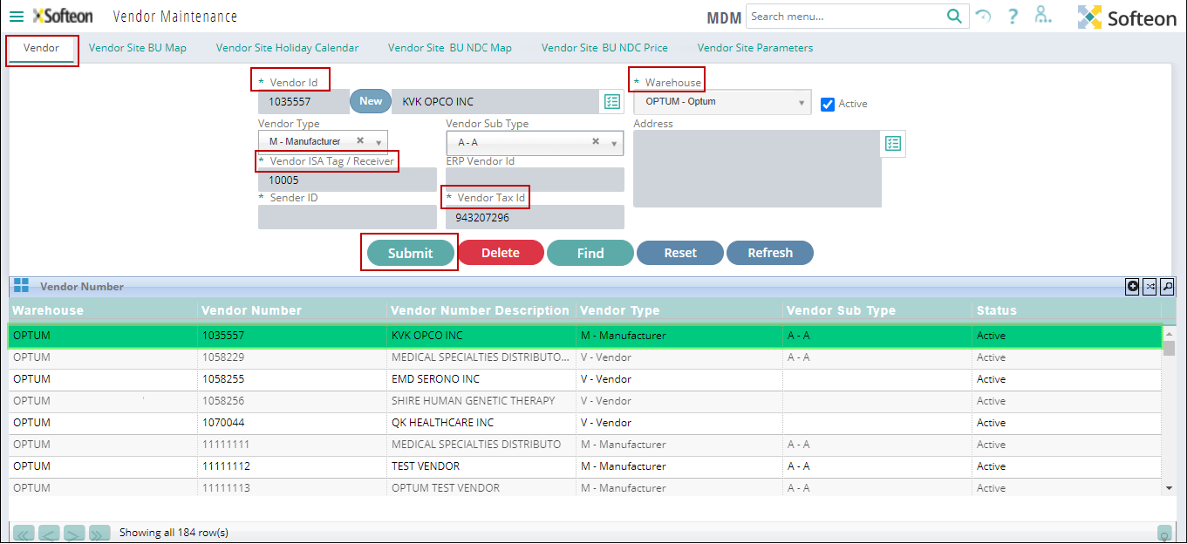

Slide 22
Maintaining Vendor Site BU Map Details
You can use the Vendor Site BU(Business unit) Map screen for mapping a Vendor with a Site and maintaining individual vendor detailsClick New to create the new Vendor and specify the description.
Select the Business Unit, Warehouse and Site to which the Vendor belongs
Click New to create the new Vendor Site ID and specify the description.
The system automatically generates the Vendor Site ID.
Select the Vendor Site Type and Vendor Site Sub Type to indicate whether the Vendor Site is of ‘Internal’, ‘Manufacturer’ or ‘Vendor’.
Select the Schedule Method as ‘Morning’, ‘Evening’ or ‘Both’ to indicate whether the inventory computation scheduler must be run only in the morning, evening, or both for the NDCs that are mapped with the Business Unit and Vendor Site.
Specify the EDI Location ID.
Click near Address and specify/select the address of the Vendor Site.

Slide 23
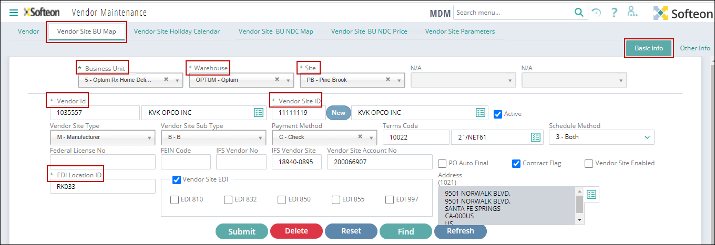

Slide 24
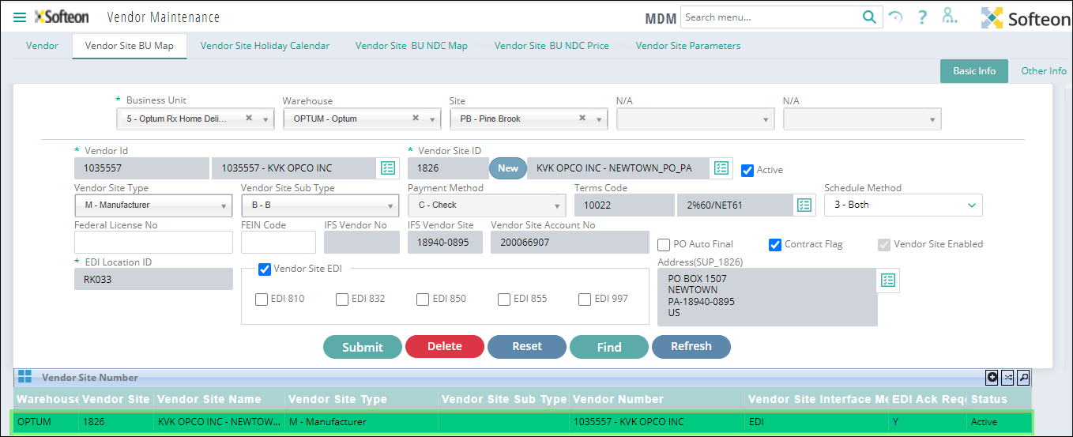

Slide 25
Mapping NDC with Vendor Site and BU
You can use the Vendor Site BU NDC(National Drug Code) Map screen for mapping an NDC Group/NDC with Vendor Site and BU
Select the Business Unit, Warehouse and Site to which the Vendor belongs
To map a NDC Group, click NDC Group Type and select the desired NDC Group Type from the list; and then select/specify the NDC Group Code.
To map an NDC, click NDC; and then select/specify the NDC Code.
Specify/select the Vendor Site Number to which the selected NDC Group or NDC must be mapped.
On clicking Submit, the system displays the defined Vendor Site, BU and NDC mapping details in the grid.

Slide 26
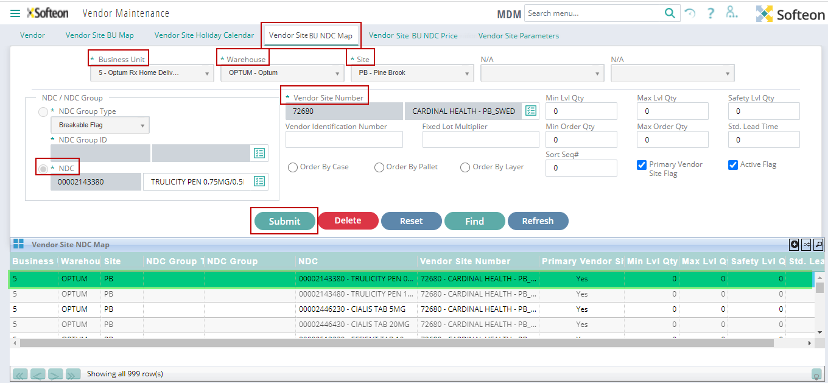

Slide 27
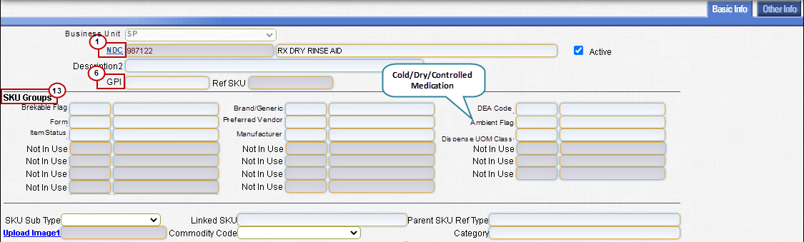
SKU Profile

Slide 28
IMPLEMENTATION PLATFORM / FRAMEWORK
Front End: Java, HTML, JDBC, jsp servlet
Backend: MySQL
Application: eclipse IDE

Slide 29
REFERENCES
https://www.ariba.com/solutions/business-needs/what-is-procure-to-pay#:~:text=Procure%2Dto%2Dpay%20is%20the,and%20reconciliation%3B%20invoicing%20and%20payment.
https://kissflow.com/procurement/procure-to-pay-process-guide/
https://www.manutan.com/blog/en/glossary/what-does-procure-to-pay-mean-definition-solutions-benefits
https://precoro.com/blog/procure-to-pay-process/

Slide 30
Thank you

